Slide 1
Transverse Wave Motion part 2
24th September 2019

Slide 2
Standing waves on a string of a fixed length
The displacement on the string at any point is given by
With the boundary condition that y = 0 at x = 0 and x = l at all times, thus
The complete expression for the displacement of the nth harmonic is given by
This may be expressed as
Where the amplitude of nth mode is given by

Slide 3
Energy of each normal modes of vibrating string
The energy in each harmonic is composed of kinetic and potential energy.
Where
Notes:
This has to be considered the unit length.

Slide 4
Standing Wave Ratio (SWR)
If a progressive wave system is partially reflected from a boundary, the incident and reflected amplitudes partially cancel out.
In this case the ratio of maximum to minimum amplitudes in the standing wave system is called
Where : the magnitude of the amplitude ratio;
Since
SWR is always greater than or equal to unity and cab be used to determine the sample’s reflection coefficient r, its absorption coefficient (α) and its impedance (Z).

Slide 5
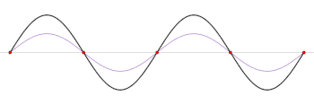
Standing wave ratio and reflection coefficient
A+B = 2 amplitudes
A-B = 0
Incident wave is fully reflected out of phase at both ends, creating a (black) standing wave. r = −1, SWR = ∞
https://en.wikipedia.org/wiki/Standing_wave_ratio
Notes:
This means the material fully reflects the incident wave. No absorption

Slide 6
An application of SWR : determination of sound absorber and absorption coefficient
The reflection coefficient r of the test sample at the end of the tube can be determined if the forward travelling sound wave and reflected sound wave can be measured separately.
The sound absorption coefficient α is the ratio of the sound power that is not reflected and the sound power incident on the absorber:
http://annals.fih.upt.ro/pdf-full/2011/ANNALS-2011-1-04.pdf
Notes:
The sound absorption coefficient α is defined as the ratio of the sound power, Wnr, that is not reflected and the sound power incident on the face of the absorber, Winc:

Slide 7
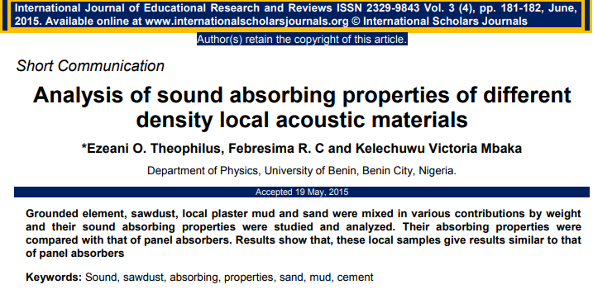

Slide 8
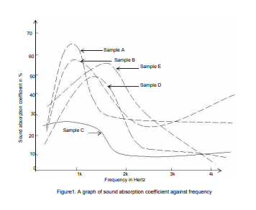
Absorption coefficient vs frequency
Sample A : sawdust, cement, sand, mud
Sample B : sawdust, cement, mud
Sample C : sawdust, cement, (more) sand, (more) mud
Sample D : cement, mud
Sample E : mud
In conclusion, the mud and a mixture of mud with cement can be effectively employed as a general purpose absorbent. This finding explains why local mud houses in most African villages serve as a haven from introducing noise.
http://www.internationalscholarsjournals.org/download.php?id=625143863717673668.pdf&type=application/pdf&op=1

Slide 9
Wave group
Superposition of two travelling waves of almost equal frequencies;
Superposition of amplitude and phase gives

Slide 10
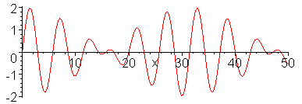
Group velocity
Consider 2 cases which are the same phase velocities and different phase velocities.
(1) The two waves have the same phase velocities; i.e., ω₁/k₁ = ω₂/k₂ = c. This leads to
This suggests that the component frequencies and their superposition, or group will travel
with the same velocity, the profile of their combination remaining constant.
http://physics.usask.ca/~hirose/ep225/animation/dispersion/anim-dispersion.html
Notes:
The same phase velocity means every wave in the group propagates with the same velocity.
The velocity of the envelope represents the group velocity.

Slide 11
Revisit the superposition of two waves of almost equal frequencies
The superposition produces an amplitude which varies between 2a and 0.
This situation is called complete or 100% modulation.
The high frequency wave is amplitude modulated.
This actually is an example of sent signal found in a communication technique for transmitting information.

Slide 12
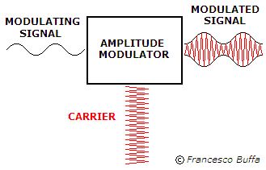
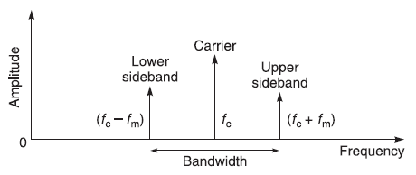
Amplitude Modulation (AM)
ω/
A general expression of an amplitude modulated wave is given as
Where the modulated amplitude
This gives
Two new frequencies (sidebands) are introduced.
ω
https://dsp.stackexchange.com/questions/47604/when-listening-in-to-an-am-signals-of-various-frequencies-how-do-we-exactly-tun
https://giphy.com/gifs/analog-BzYOp24AXnHEI
Notes:
Amplitude modulation of a carrier frequency is a common form of radio transmission, but its generation of sidebands has led to the crowding of radio frequencies and interference between stations.

Slide 13
Group velocity (contd.)
(2) Two frequencies components have different phase velocities so that ω₁/k₁ ≠ ω₂/k₂.
The group velocity is given as
  The superposition of the two waves will no longer remain constant and the group profile will change with time.
  If a group contains a number of components of frequencies which are nearly equal, the original expression for the group velocity is written

Slide 14
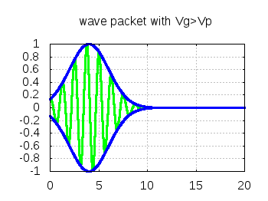

Dispersion relation
A medium in which the phase velocity is frequency dependent (ω/k not constant) is known as a dispersive medium and a dispersion relation expresses the variation of ω as a function of k.
This leads to three possible changes with time of the group velocity profile relative to the phase velocity.
They include
(1) v_{g} = v : a non-dispersive relation
(2) v_{g} < v : a normal dispersion relation
(3) v_{g} > v : an anomalous dispersion relation
http://theory.ipp.ac.cn/~yj/free_software.html

Slide 15
Illustration of dispersion relation
Since ω = kv,
This term can be either positive or negative.
↑ v ↑ : v_{g} < v (normal dispersion)
↑ v ↓ : v_{g} > v (anomalous dispersion)
Notes:
For normal dispersion ความยาวคลื่นยิ่งยาว ความเร็วยิ่งมาก คลื่นความยาวคลื่นยาววิ่ง “เร็ว” กว่าคลื่นความยาวคลื่นสั้น (v > vg)
For anomalous dispersion ความยาวคลื่นยิ่งยาว ความเร็วยิ่งน้อย คลื่นความยาวคลื่นยาววิ่ง “ ช้า “กว่าคลื่นความยาวคลื่นสั้น (v < vg)
Dispersion relation เป็นกราฟระหว่าง ω และ k

Slide 16
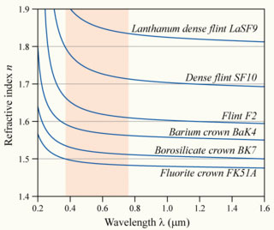
The dependence of refractive index to wavelength for various glasses
Are these various types of glasses non dispersive, normal dispersive or anomalous dispersive?
These are dispersive media because the phase velocity of each wavelength is not equal. This can be seen from the wavelength dependent refractive index.
Also, longer wavelengths move faster than shorter wavelength. This dispersive medium is categorized as the normal dispersive medium.
http://microscopy.berkeley.edu/courses/tlm/optics/chromatic.html
Notes:
They are normal dispersive because longer wavelengths have higher speeds than the shorter wavelengths.
In other words, dv/dλ > 0 and this corresponds to the condition of normal dispersive medium.

Slide 17
Problem 5.17
It was found previously that the relative permittivity of an ionized gas is given by
This indicates that the relative permittivity is a function of frequency.
Show that the dispersion relation is given as
Notes:
By changing the frequency of the applied em, the refractive index n (=(εr)^1/2) and impedance (z= (ε/μ)^1/2) are also changed)

Slide 18
Transverse waves in a periodic structures representing a 1D crystal structure with identical single atom separated by a crystal lattice a
Consider the propagation of transverse waves along a linear array of atoms, mass m, in a crystal lattice where the tension T represents the elastic force between the atoms and a is the separation between atoms (so that T/a is the stiffness).
The displacement of rth particle due to the transverse waves is given as
By substituting the displacement into the equation of motion :
The permitted frequencies are found to be
This actually is the dispersion relation for waves travelling along a linear one dimensional array of atoms in a periodic structure.
Notes:
X=ra = ตำแหน่งของ displacement สำหรับ อนุภาคตัวที่ r
Permitted frequencies คือ ชุดค่าความถี่ของคลื่นที่เคลื่อนที่ผ่าน linear periodic structure นี้ได

Slide 19
An alternative way to derive the equation of motion in case of the one dimensional lattice vibration
For simplicity, the forces between the atoms in a one-dimensional crystal lattice is assumed to be proportional to relative displacements from the equilibrium positions.
Equation of motion for rth mass:
Due to the stiffness C = T/a; therefore
y_{r-1}
y_{r}
y_{r+1}
r-1
r
r+1
a
https://unlcms.unl.edu/cas/physics/tsymbal/teaching/SSP-927/Section%2005_Lattice_Vibrations.pdf

Slide 20
What is the permitted frequency?
The expression for ω² is equivalent to jth normal mode frequency of a transverse wave on loaded string,
If (Show this?)
Therefore, the permitted frequency is actually the normal mode frequency of the transverse wave existing in the linear array of atoms in a periodic structure.
Permitted frequency
Notes:
โดยสรุปคือ permitted frequency คือ normal mode frequency

Slide 21
Show
Recall (n+1)a = the length of the string or crystal, therefore
Also, the allowed wavelengths have to satisfy with ; where p is an integer.
Thus,
Because j and p are integers and they can be equal ( j = p) to indicate a particular normal mode of interest. Provided that k = 2π/λ, we then can conclude that

Slide 22
The maximum permitted frequency is found to be
This gives ka = π → λ =2a which is the allowed minimum wavelength for the transverse wave to propagate along the linear array of atoms in a periodic structure.
The graph below shows the dispersion relation (ω vs k) for the linear array atoms.
Due to , the permitted frequency is then represented as
The frequency and the displacement of the atoms do not change when k is greater than the 1st Brillouin zone.
Note that the repetition values of ω beyond the region -π/a≤ k ≤π/a, this region defines a Brillouin zone.
1st Brillouin zone
Notes:
Note that at the boundary of BZ k = pi/a, vg = dw/dk = 0
Structure นี้ตอบสนองต่อความถี่ที่ตำกว่า maximum permitted frequency หรือกล่าวได้ว่าตอบสนองต่อความยาวคลื่นที่มากกว่า allowed minimum wavelength
The highest frequency associates with the maximum coupling.

Slide 23
Dispersion relation for travelling long and short wavelength waves in a periodic structure
For long wavelengths or low values of the wave number k, sin ka/2 → ka/2
For short wavelengths, the phase velocity is given by
Note : only at very short wavelengths does the atomic spacing of the crystal structure affect the speed of the wave propagation.
Wave velocity
Notes:
สำหรับคลื่นที่มีความยาวคลื่นสั้น ๆ เท่านั้น การ propagate ของมันจึงได้รับผลจาก atomic spacing

Slide 24
Dispersion relation for travelling waves in a periodic structure
Recall the dispersion relation:
The maximum permitted frequency is obtained when
Example : the elastic force constant T/a for a crystal is about 15 Nm⁻¹ and a typical reduced atomic mass is about 60 x 10⁻²⁷ kg. The maximum frequency is found to be about 5 x 10¹² Hz.
Permitted frequency
The maximum frequency is known as CUT OFF frequency.
Notes:
The frequency is in the infrared range of em spectrum.

Slide 25
Linear array of two kinds of atoms in an ionic crystal
In this case, a one dimensional line which contains two kinds of atoms with separation a is considered.
Given that atoms of mass M occupying the odd numbered positions and those of mass m occupying the even numbered positioned, the equation of motion for each type are
With solutions
This gives the dispersion relation as

Slide 26
An alternative way to derive the equation of motion in case of the diatomic one dimensional lattice vibration
For simplicity, the forces between the atoms in a one-dimensional diatomic crystal lattice is assumed to be proportional to relative displacements from the equilibrium positions.
Equation of motion for 2rth mass:
Equation of motion for (2r+1)th mass :
Due to the stiffness C = T/a; therefore
y_{2r-1}
y_{2r}
y_{2r+1}
y_{2r+1}
M
m
2r-1
2r
2r+1
2r+2
a
https://unlcms.unl.edu/cas/physics/tsymbal/teaching/SSP-927/Section%2005_Lattice_Vibrations.pdf

Slide 27
Derivation of the dispersion relation
From the equations of motion found earlier,
By arranging the above equations in the following matrix form, the dispersion relation can be worked out.

Slide 28
Dispersion relation for the ionic crystal structure
Provided that m > M.
Notice that the dispersion relation gives two possible situations.
With the positive sign, the change of ω as a function of k is considered.
The range of the wave number covers from k = 0 to k_{max} = π/2a (minimum λ = 4a)
For k = 0
For k_{max}
Note : ω_{max} is obtained when the minimum wavelength corresponds to 4a instead of 2a as found in the case of vibration in monatomic crystal structure).
Notes:
The minimum λ can be found from dω/dk = 0

Slide 29
Dispersion relation for the ionic crystal structure
Provided that m > M.
Notice that the dispersion relation gives two possible situations.
With the negative sign, the change of ω as a function of k is considered.
The range of the wave number covers from k = 0 to k_{max} = π/2a (minimum λ = 4a)
For k = 0 ; For small k
For k_{max}
Notes:
The minimum λ can be found from dω/dk = 0

Slide 30
Dispersion relation for two modes of transverse oscillation in a crystal structure
According to the dispersion relation, two possible solutions can be found for m > M.
They are optical mode (upper branch) and acoustic mode (lower branch).
Also there is a forbidden band (band gap) of frequencies between the two branches that the wave cannot propagate.
The band gap depends on the differences of masses.
Band gap
m>M

Slide 31
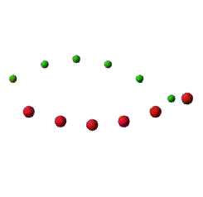

The motions of the two types of atom for each branch at k → 0 (long wavelength)
Optical mode for long wavelength and small k, A_{m}/A_{M} = -M/m
The atoms vibrate against each other, the center of mass of the
unit cell in the crystal remains fixed.
Acoustic mode for long wavelength and small k, A_{m} =A_{M}
Atoms and their center of mass move together.
http://slideplayer.com/slide/9413111/
Notes:
For the acoustic branch, the two atoms in the cell have the same amplitude and the phase. Therefore, the molecule oscillates as a rigid body.
For the optical branch, the optical oscillation takes place in such a way that the center of mass of a molecule remains fixed. The frequency of these vibrations lies in infrared region which is the reason for referring to this branch as optical.

Slide 32
Derivation of the motions of the two types of atom for each branch
Recall the equation of motion for the ionic crystal structure previously discussed,
The relative motion between m and M with a small k can be found when suitable frequency for each branch is considered.

Slide 33
Optical branch
Using one of the two equations from the matrix
For k = 0 →
The relative motion is found to be
Acoustic branch
Using one of the two equations from the matrix
For k = 0 →
The relative motion is found to be
Notes:
For acoustic branch, So in this limit the two atoms in the cell have the same amplitude and the phase.

Slide 34
Example : Absorption of infrared radiation by ionic crystal
Suppose the ionic crystals composed of ions of opposite charges ±e move under the influence of the electric field E = E₀exp(iωt).
The equation of motion can be written as
Appropriate displacement for each ion is given as follows

Slide 35
However, the analysis can be simplified by neglecting the wavenumber k.
Assuming that the electric field is infrared and its wavelength is around 10⁻⁴ m.
This gives the wave number k ≈ 6×10⁴ m⁻¹. This value is negligible when comparing to the k_{m} which is the limit of wave number at the boundary of 1st Brillouin zone. Approximately, k_{m} is found to be π/2a where a = 10⁻¹⁰ m.
This can simplify the equations of motion for each ion to be

Slide 36
The amplitudes for both ions are found to be
Where
When ω=ω₀, the ions amplitude increases meaning a strong absorption by ionic crystals
This actually is the low k limit of the optical branch.

Slide 37
Problem 5.21
λNaCl ≈ 51 μm, λKCl ≈ 60 μm

Slide 38
Homework
5.27, 5.28

